Slide 1

AI Agent Repository
Post-Interview Requirements Review and Workshop
Darmstadt | 12.10.2026

Slide 2
Agenda
01
Project timeline
13:00-13:15
02
Interview Summary + Main Findings
13:15-13:50
03
Discussion: What is the entry requirement?
13:50-15:00
Break 15 min
04
MVP Suggestion
16:00-16:30
06
Review & Confirm: Requirements
15:15-16:00
Break 10 min
07
Decisions & Next Steps
15:30-16:00

Slide 3
Today’s objectives
        Give an overview
          Where do we stand today across platforms and existing governance? What did we hear consistently across interviews: shared pain points, wishes, and open questions? What should we park for now, and revisit later?
        Review & Discuss Requirements
          What counts as an "agent" in scope and what doesn't? What must a registered agent fulfill: ownership, risk classification, lifecycle, access? Where do requirements conflict or have gaps?
01
02
Over the past weeks, we ran structured interviews across sectors (Life Science, Healthcare, Electronics, Enabling Functions) and platform owners (UPTIMIZE, myGPT, Salesforce, SAP Joule, UiPath, MS Copilot). Several of you already contributed directly.
This workshop turns that input into aligned requirements and a concrete MVP scope.
        Scope and Sign-Off
          What goes into the MVP in scope, out of scope, parked for later? What would make this fail, and what haven't we considered? What do we agree today, and how do we proceed?
03

Slide 4
Project Scope at a glance
        Phase 1 - Design
        Phase 2 - Build
We are here
          Collect requirements across AI agents, governance, products and architecture
          Facilitate “value of agent” discussion to align repository scope
          Access feasibility and integration requirements for key platforms
          Design data model (extension) and target architecture
          Implementation of AI Agent Repository based on signed-off architecture (into data marketplace)
          Build integration to defined platforms
          Central dashboard for monitoring and managing agent inventory
          > Requirements, scope (MVP) and clear concept with refined click-dummy / demov
          > Production-ready AI Agent Repository with live platform integration and central dashboarding
Merck | AI Agent Repository Requirement Review

Slide 5
Interview Summary
Business Areas
Healthcare (HIVE)
Electronics
12 Interviews
Agentic AI @UPTIMIZE
Life Science
Enabling Functions
UPTIMIZE Foundry
UPTIMIZE Agents
29
Stake-holders
myGPT
MS Copilot
Platforms / SaaS
SAP Joule
UI Path
Salesforce
Merck | AI Agent Repository Requirement Review

Slide 6
Interview Summary
Date | Interviewee | Area Of Expertise
2026-09-17 | Dominik A. Schneider | Architecture
2026-09-21 | Kristina Bausen | AI Governance
2026-09-23 | Harsha Gurulingappa; Shikhar Bhardwaj; Oliver Vetter; Florian Metz | UPTIMIZE Agents, Integration Hub, myGPT
2026-09-29 | Mike Jung; Carsten Goepp; Olivier Dury | Life Science
2026-09-30 | Vladimir Stojanovic | Electronics
2026-09-30 | Anand Deshpande; Prasanthi Desiraju | SAP Joule
2026-10-02 | Natalia Smeljanski | Enabling Functions
2026-10-02 | Florens Focke; Sylvain Cecilio; Rolf Roth; Alexander Helmboldt; Kartik Vijay; Pranav Khurana; Nadia Terranova | Healthcare, HIVE
2026-10-02 | Rajkumar Ramaswamy; Hari Singh | Salesforce
2026-10-02 | Katharina Egert | UPTIMIZE Foundry
2026-10-05 | Harish Thimmegowda; Hanif Choudhury; Kiran Colonakuduru; Riyaj Adam Makandar | UIPath
2026-10-05 | Igor Lakic | MS Copilot Studios

Slide 7
The majority sees the need of the same requirements
The needs for a cross-platform transparency as the baseline
Minimum information set per agent - owner/contact, risk level, description, cost
A business layer separate from the technical catalog - technical and a separate, business-oriented view
Cost transparency per agent – warn business users before expensive usage
Focus on reuse before rebuild – using existing agents than using more
Audit trail & traceability of changes – security/compliance requirement
Risk-based access – who can see or use what, tied to risk classification, data input / output, business area
Merck | AI Agent Repository Requirement Review

Slide 8
Architecture Overview

Slide 9
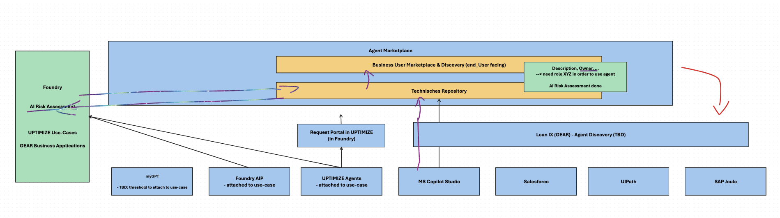

Slide 10
Component | Status quo (from interviews) | What we can leverage | Why parked / not
UPTIMIZE Foundry / AIP | Use Case-level AI Flag + Self-Assessment already operational; risk classification tied 1:1 to Use Case; agentic assets show up as "outcomes" in Foundry UI | Existing risk assessment logic, Use Case–agent linkage, established owner-self-service model | In scope — most mature governance foundation; primary source for risk status
myGPT Suite (Langdock) | ~10,334 agents, only 235 with >20 users; built-in Langdock Governance tool scans for EU AI Act/GDPR/PII patterns; agent-to-Use Case link only exists for advanced features; creator identity is hashed, no clean org/department join yet | Governance scan output as a signal (not a substitute for formal assessment); usage/cost dataset in Data Treasury; existing HR-mapping approach (Florian's dashboard) as a template | In scope, but metadata enrichment (owner, business capability) is a known gap to solve, not a reason to exclude
UPTIMIZE Agents / Integration Hub | Technical registry for MCP servers and some deployable agents; not yet production-launched; nothing business-critical registered yet; governance model still in development (Oliver) | Technical endpoint/tool/auth metadata once available; natural fit as a connector source rather than a business-facing layer | In scope for technical metadata feed; not a target UI — stays backend source
LeanIX / GEAR | Only receives a binary AI yes/no flag from UPTIMIZE today (deliberate, IT doesn't want more synced in); native "AI Agent Discovery" capability unexplored | Business-capability mapping, enterprise architecture context, possible alternative to custom vendor integrations | In scope as a context/discovery feed; feasibility of native AI Agent Discovery still an open question, not a blocker to MVP
Salesforce (Agentforce) | Different DDIT organization; not currently visible to UPTIMIZE/MDAO team; mentioned as a known blind spot (Dominik, Olivier) | — | Parked — no connector, no owner contact yet confirmed, unknown volume
ServiceNow | AI capability exists, not integrated; explicitly named as a gap by Kristina | — | Parked — same reasoning
SAP Joule | Minimal engagement from Life Science platform team; "not calling in Mike's/Carsten's responsibility" | — | Parked — low confirmed volume, but flag: not yet risk-screened, revisit if a high-risk use case surfaces
UiPath | Named in original scope, but no interview evidence of active agent volume yet | — | Parked — same reasoning as SAP Joule
MS Copilot Studio | Business teams may build agents; governance path unclear (Gernot's and Kristina's open question: GEAR vs. UPTIMIZE, who owns flagging) | — | Parked, but this one needs a one-line caveat: unlike SAP Joule/UiPath, this is parked due to unresolved ownership, not low volume — don't let the room conflate the two reasons
HIVE (Agentic AI Platform Layer) | Live since late Sept 2026 (staggered rollout, 3 workflows so far); target architecture positions the planned Hive Agent Store as composed of Integration Hub + UPTIMIZE Agents, not a separate registry; no flag mechanism yet exists to mark a Hive agent "reusable" — publishing is a manual, conscious step by the agent owner, not an automatic sync | Target architecture as the forward-looking frame for where Integration Hub/UPTIMIZE Agents are heading; the Agent Card concept (below) as a possible metadata bundle | In scope for target state; not yet queryable — no confirmed API/Swagger extraction path exists today (uncertain even to Hive's own lead), likely manual/portal-based owner upload initially

Slide 11
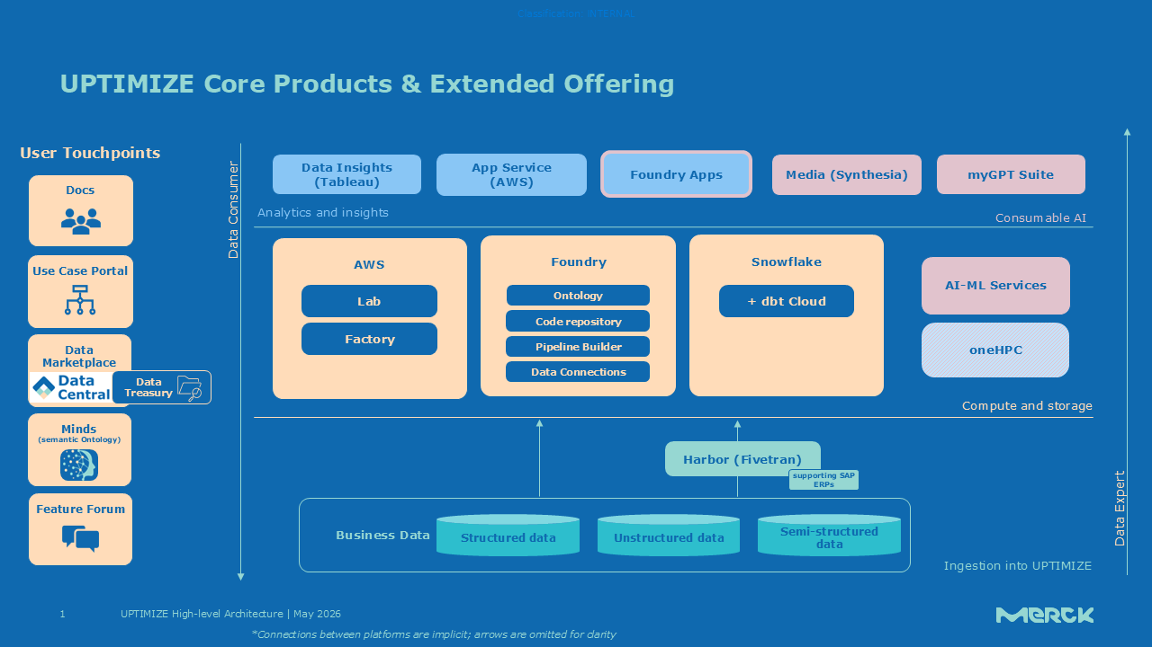
Where are we today?

Slide 12
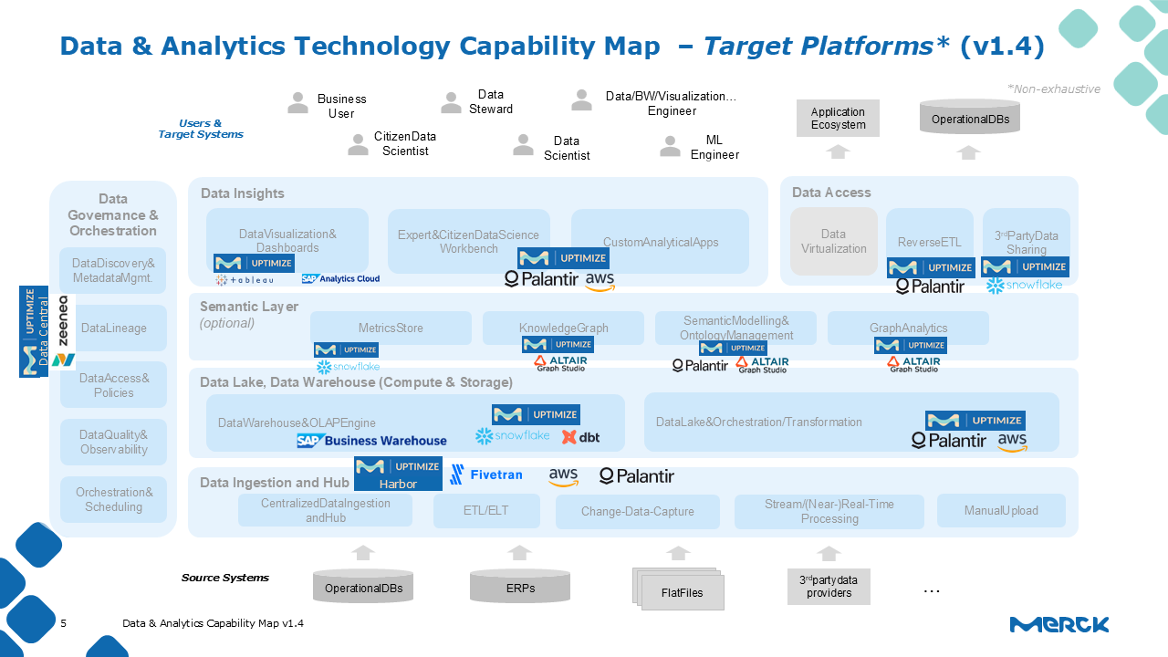

Slide 13
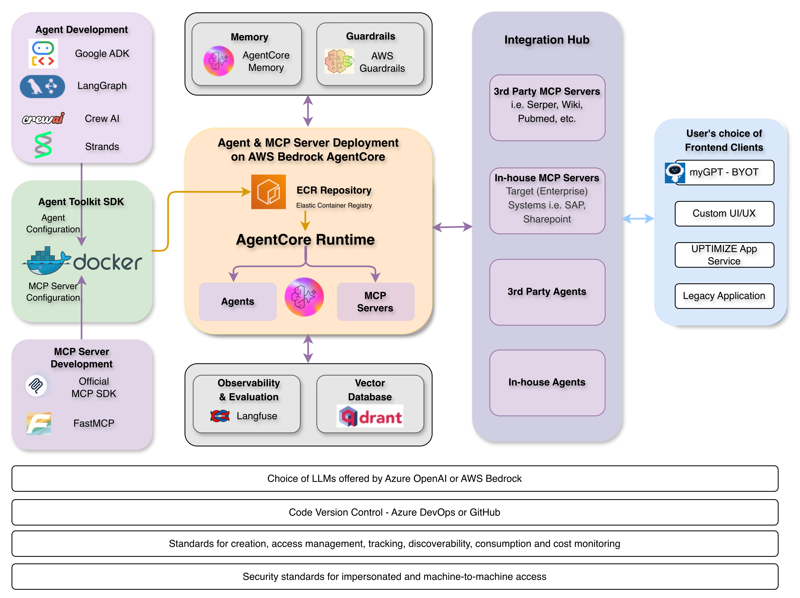

Slide 14
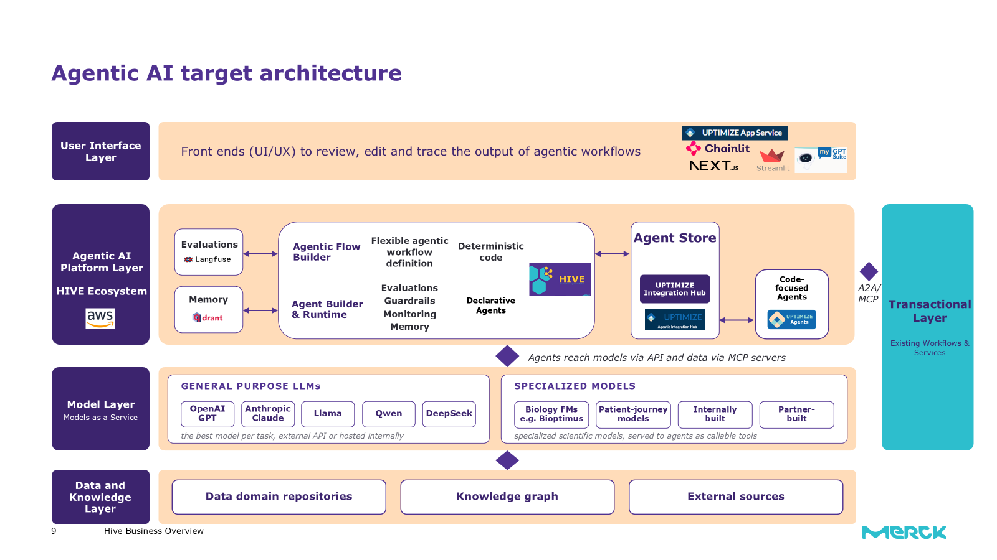

Slide 15
What are the entry requirements?
1
BRAINSTORMING
Central Questions
Are we going to include all agents in the repository?
What should be the filters?
2
Goal: Align on the baseline
PRIORITIZATION
In scope / out of scope / parked
3
COMPLEMENT
Notes:
Beispiele: private agente, team-shared agent, embedded, code-shared, orchestrator + sub-agent

Slide 16
What governance requirements need to be fulfilled ?
Central Areas
Ownership
Who's accountable? Which accountability does it take?
Risk Classification
Agent- or use-case-level? Does a sub-agent inherit it? + GXP
Lifecycle
Versioning, re-assessment trigger, use case lifecycle?
Trust
„Certified“, rating?
Data in/out
Sources, sensitivity, lineage
Access
Request / approval workflow; who gets to have access to what?

Slide 17
Three textboxes with conclusion
        Findings
UPTIMIZE/Foundry Use Case AI assessment is already mature
iHub registers MCPs/agents technically, with no automatic link to the Use Case – that link happens separately in Foundry as an "outcome."
myGPT: ~10,334 total agents, only ~200 with a Use Case attached (<2%) – the vast majority is effectively ungoverned
LeanIX/GEAR holds only the bare AI flag, nothing deeper
Vendor platforms (ServiceNow, Salesforce, SAP Joule, Copilot) are practically invisible from a governance standpoint
        Pain Points
Missing department/capability mapping for myGPT agents
The technical catalog doesn't answer business questions – risk, purpose, target audience are missing
Unclear definition of "agent" undermines consistent governance
Embedded/third-party agents (e.g., SAP Joule directly inside the SAP UI) may run entirely outside myGPT and iHub – remain invisible
Cost pipeline for UPTIMIZE Agents not yet stable
Access process for existing MCPs is cumbersome – 3–4 manual steps
Risk of a "second dashboard hype": lots of artifacts, little upkeep, repository becomes a dead compliance register instead of a used tool
        Wishes
A user rating/flagging mechanism
A certification/trust stamp for especially reliable agents
A semantic context layer so agents/systems can themselves recognize which MCPs are relevant
Full lineage/status transparency across multi-agent chains for debugging
Distinction between internal vs. external agents, since external exposure is expected to grow
Feedback loop back into the creation tool itself – e.g., a prompt inside myGPT before building a new agent, flagging whether something similar already exists

Slide 18
1. Baseline / Eligibility
What has to be true for an agent to appear in the repository at all?
Use Case binding: mandatory, optional, or platform-dependent?
Risk-assessment status as an entry requirement or applied downstream?
Minimum threshold (e.g., as with myGPT: >20 users as a signal) as a filter criterion?
2. Metadata Schema
Separate from Baseline – what gets maintained once something is in?
Mandatory fields: owner/contact, description, risk level, cost (core set per Kristina/Carsten)
Optional/discovery fields: business capability, platform, usage statistics
Inheritance from the Use Case vs. override by the agent owner (Oliver's draft model as the starting point)
3. Access & Security
Who can see (read) vs. who can use/request access?
Coupling to risk classification (does High Risk mean restricted access?)
Is today's "everyone sees everything" model (Kristina: "anyone can look in") the target state or just a transitional one?
4. Hierarchy & Relationships
Agent Asset vs. Agent Product (composition: a Product aggregates several Assets)
Mapping to Use Case/Application as the higher-level governance unit
Explicitly out of MVP scope: lineage to data products/tables (per Oliver, a Foundry topic, not a repository task)
5. Lifecycle & Change Management
Status model (e.g., draft/registered/assessed/deprecated/archived)
"Last updated" field as a minimum (Kristina's point about stale entries)
Reassessment triggers on change (data/tools/permissions) – MVP or Phase 2?
Retention/deletion periods – currently unresolved, should at least be documented as an open question
6. Ingestion Scope per Platform
Automated (UPTIMIZE: iHub, Foundry, myGPT via Data Treasury) vs. manual/unknown (ServiceNow, Salesforce, SAP Joule, Copilot)
Known data gaps per platform (e.g., myGPT: hashed user IDs, no clean owner mapping)
Clear labeling: "known coverage gap, deliberately out of Phase 1"
7. Trust & Quality Signals
User rating/flagging, certification stamp (Carsten, Gernot)
Decision needed: MVP-relevant or explicitly Phase 2 – should be named as an open point, not silently dropped

Slide 19
What are major questions to be defined?
What is the required minimum for an agent to be registered in the repository?
  Tied to higher instance (e.g. use case)?
  AI risk assessment executed?
  Owner + Back-Up Owner defined?
  Further points?
  What is the minimum required information that needs to be available in the repository?
  Owner, lineage, data input / output, etc.
Token limitation (weekly) in myGPT pro Model unlimiert
Alles was über Andere läuft in myGPT
Agenten wie z. B VERA (HR) unlimitiert nutzen können
→ Eventuell ein Tag “unlimited use”, “limitation use may apply”

Slide 20
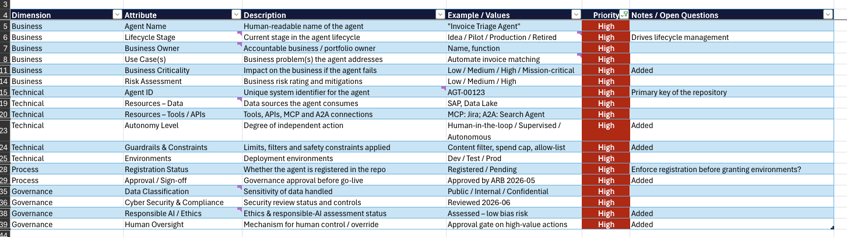
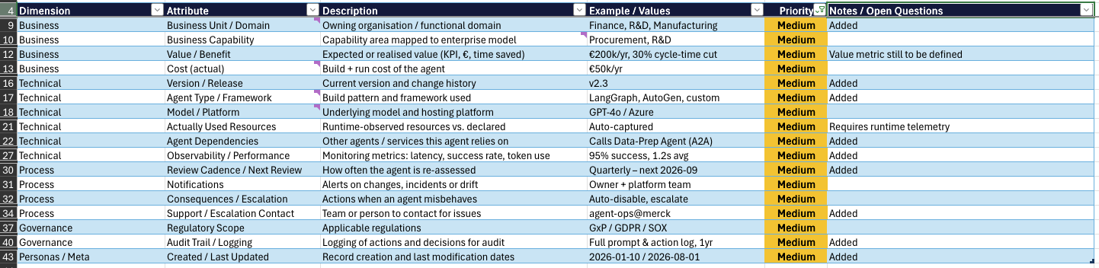
Minimum Requirements

Slide 21
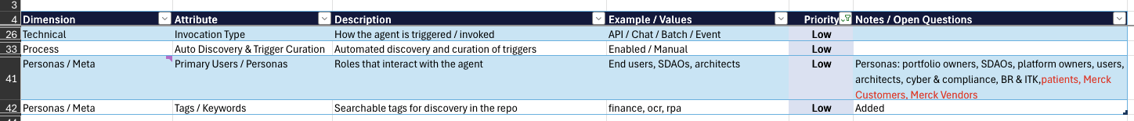
Governance/Tech | Emergency exist /shut-down strategy | A developed, tested and documeted process to shut down an agent in case of emergency or serious misbehaviour |  | High
Personas /Meta | First registration performed by (name) | Person, who performed first registrion |  | Low | for audit trail purpose
Personas/Meta | Modification performed by | Person, who performed modfications |  | Low | for audit trail purpose
Meta | Modified fields | Last modified attributes |  | Low | for audit trail purpose
Business | Agent cost center | The Merck Entity Number which will cover costs for agent run |  | Low | For cost and value management
Technical /Governance | Agent solution type | Ist it single Agent Asset or Agent Product or both |  | Medium | In the future can be used as primary and group layer. For Agent product a single agent assets may be added to agent dependencies

Slide 22
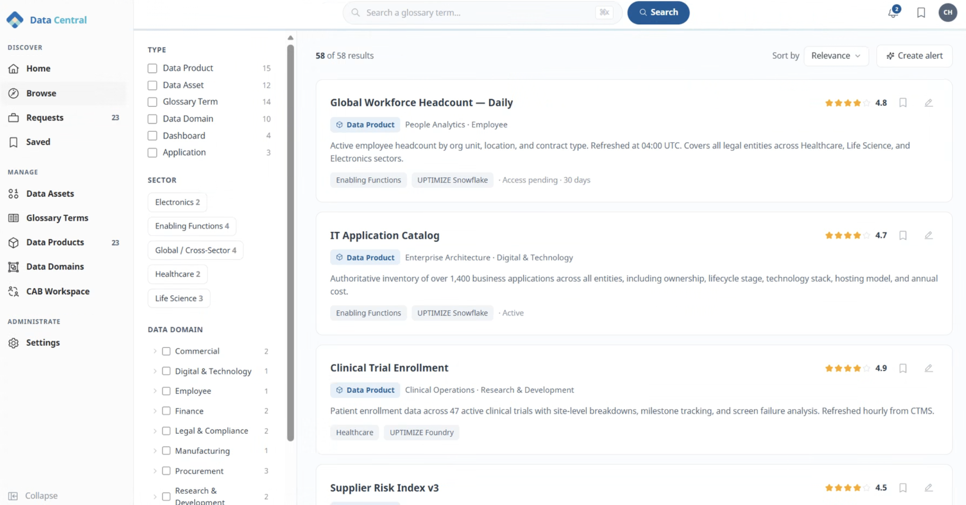

Slide 23
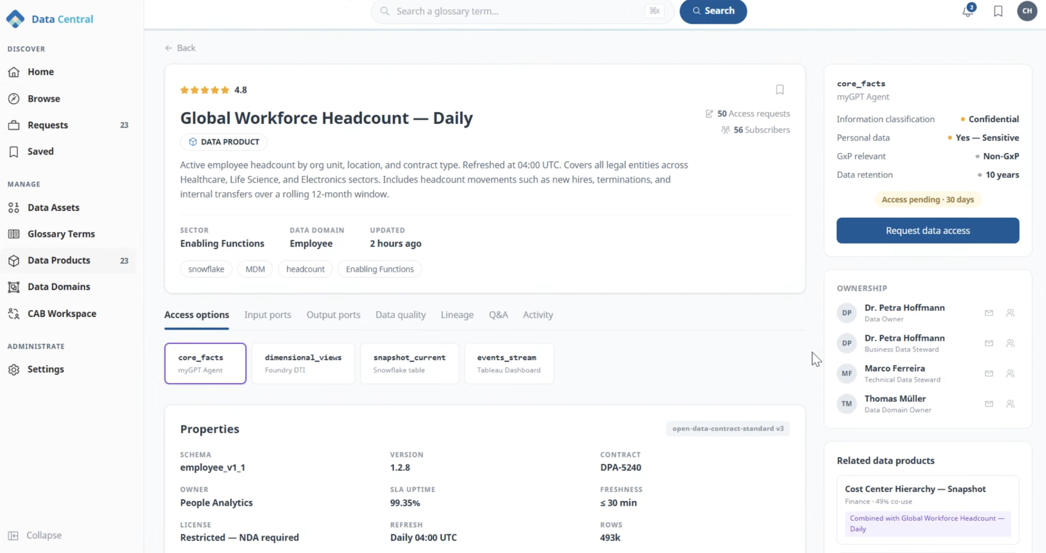

Slide 24
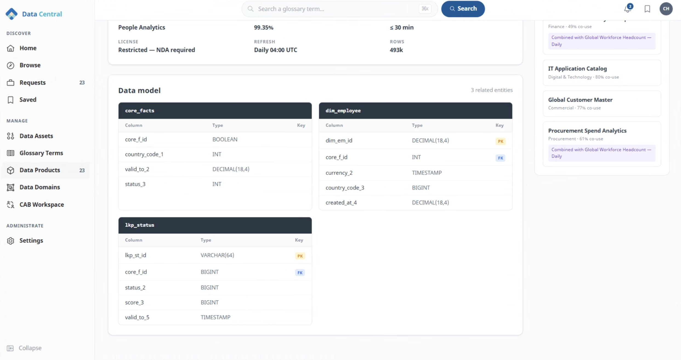

Slide 25
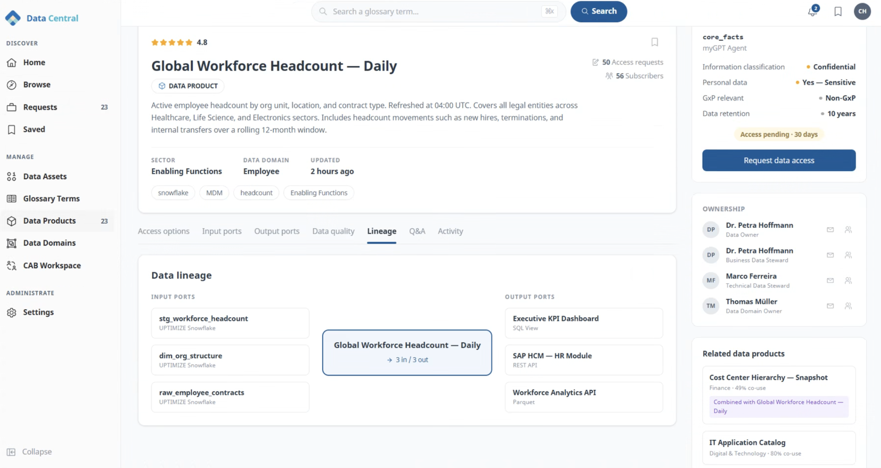

Slide 26
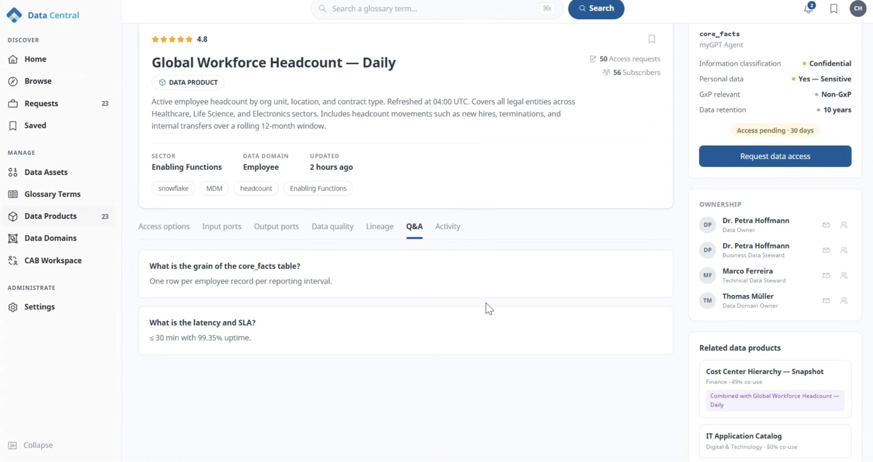
Notes:
+ lifecycle (status)

Slide 27
Summary requirements for MVP for sign
Minimum attributes

Slide 28












Copy elements
Edit text by clicking on it. Use the "Increase/decrease list level" buttons on the Start tab to switch between the text levels set up.
  Second level
    Third level
      Fourth level
        Fifth level
          Sixth level
            Seventh level
              Eighth level
                Ninth level
Text Stopper
Text Stopper

